Slide 1

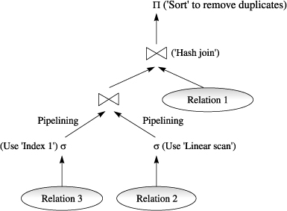
Query Processing on NVM
Koh Yi Da FYP CA Presentation AY 21/22

Slide 2

Problem Description
Given the limited write endurance of Non-Volatile Memory (NVM) such as the Intel Optane DCPMM, we want to devise novel sorting algorithms for large datasets that limit the number of writes, while still being efficient and scalable. In particular we seek to address the two considerations: (1) Minimal (ie. O(n)) write complexity in NVM to reduce hardware wearing (2) Practical time efficiency and scalability

Slide 3
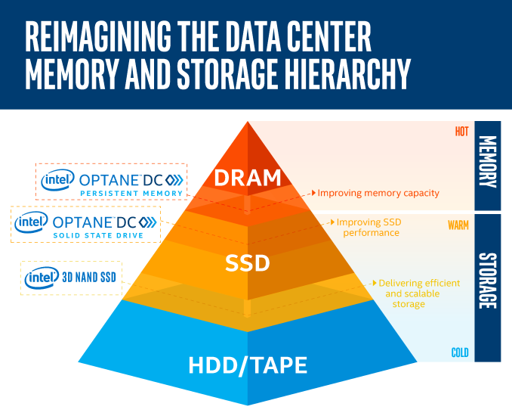
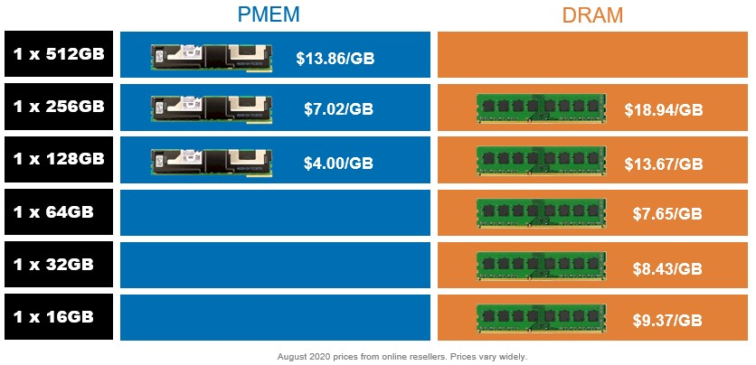
What is Non-Volatile Memory?
“In-between” DRAM and SSD/Disk
DRAM Comparable Read-Write speed
Persistence, unlike DRAM
Cost Effective, Cheap, Easy-to-scale

Slide 4
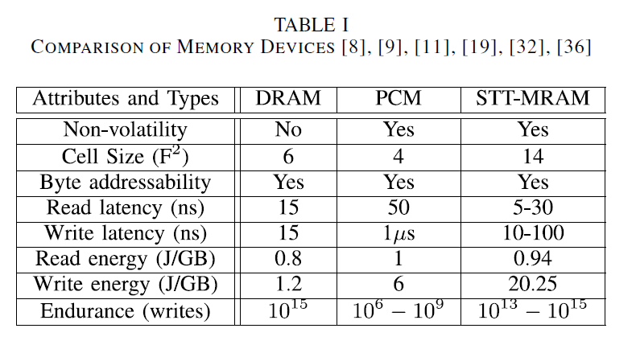
What are the trade-offs?
Read vs. Write latency asymmetry
Read vs Write bandwidth asymmetry
Limited write endurance (compared to DRAM)
Empirical studies show Intel Optane DCPMM 3x slower read latency than DRAM, similar write latency

Slide 5
NVM Context in Query Processing?
Database systems typically house large datasets
DRAM has limited size, is expensive
IO overhead and complexity in moving between disk and DRAM
Often requires persistence
Cannot use traditional in-memory algorithms
Sorting is a fundamental and common operation in Query Processing
“Facebook generates 4 petabytes of data per day—that's a million gigabytes.” Facebook 2020 Statistics

Slide 6
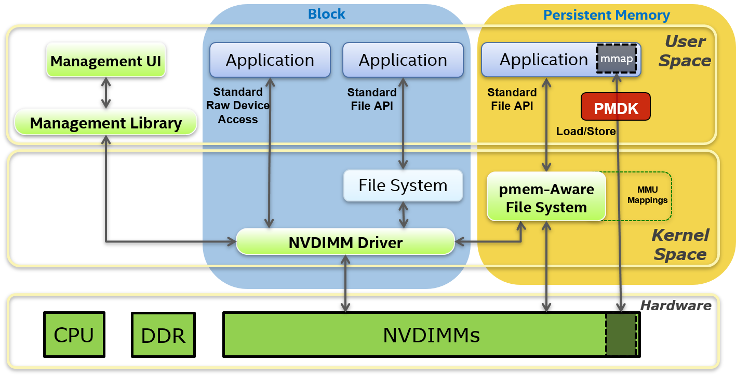
How does NVM help?
Byte-addressable memory
Much simplified IO
Intel PMDK Library exposes NVM directly to user space
Increased throughput, reduced latency
Works alongside DRAM
Direct Access (DAX)

Slide 7
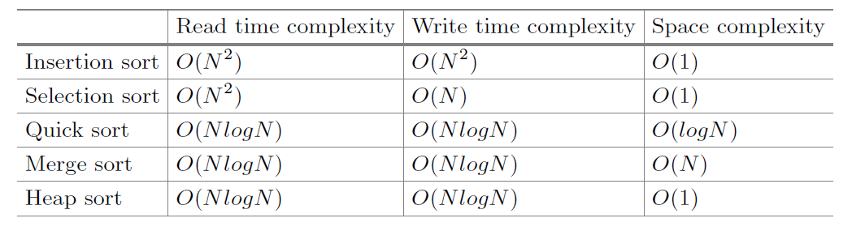
Sorting in NVM – The Problem
Standard sorting algorithms generally have high write volume
Selection Sort is O(n) writes, but O(n²) overall complexity
Assume large file is in NVM
File might not even fit in DRAM

Slide 8
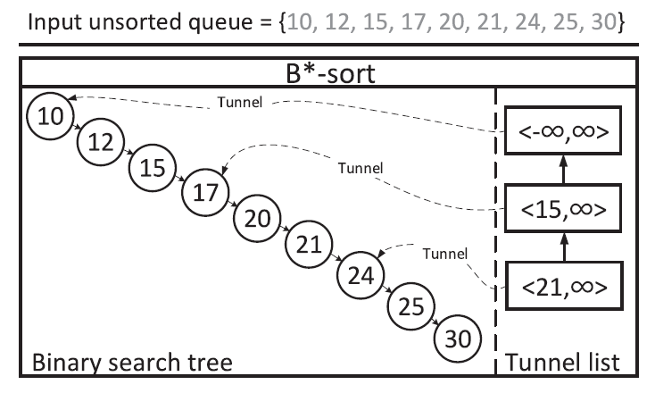
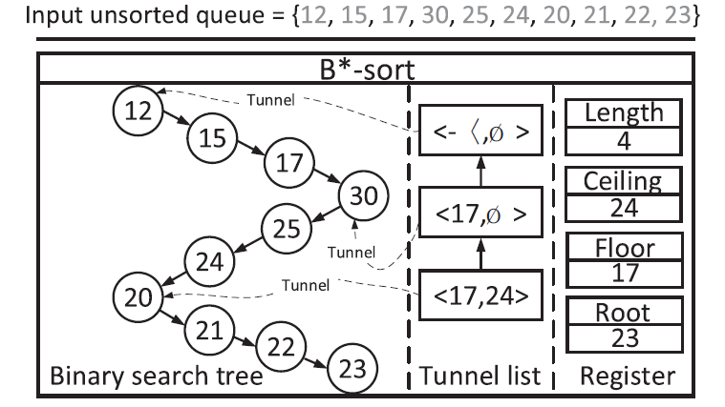
Literature Review – B*-sort
Some research effort into NVM-aware sort
“Write Once” guarantee (ie. exactly n writes)
Binary Search Tree inspired (non-balancing)
“Tunnel Entries” instead of tree-balancing
Divide BST logically into sub-BSTs of size sqrt(n)
Keep lightweight tunnel entries and metadata registers in DRAM

Slide 9
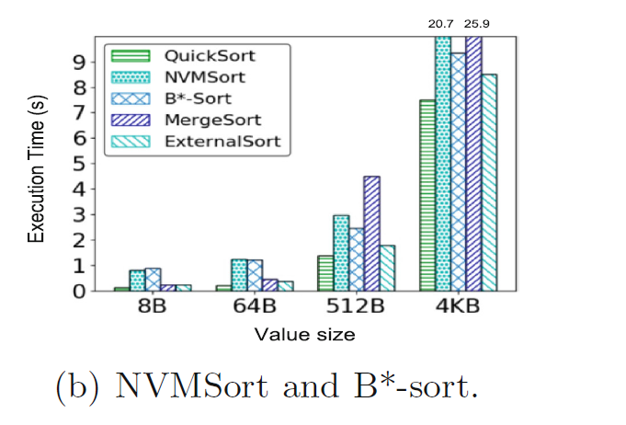
Literature Review – B*-sort
Tested and evaluated on DRAM-simulated NVM environment
Pessimistic assumption about writes to NVM
Assumed NVM writes much more costly
Worst case O(n) writes, O(n * sqrt(n)) reads
Average case O(n) writes, O(n logn) reads
Empirically shown to be rather slow in practice on the Intel Optane

Slide 10
Literature Review – Pointer Indirection
No need to sort actual Records
Just sort pointer to the Record
(key, pointer) pairs instead of (key, value) pairs
Significantly reduce size of each sortable element
Scalable to large values. Keys tend to stay small
Some overhead in dereferencing pointer after sorting
Reduce size (in bytes) of single write to NVM
4
value
4
ptr
Notes:
Pointer Indirection works because byte-addressable

Slide 11
Literature Review – Pointer Indirection
4
value
2
value
5
value
1
value
3
value
6
value
Create (key, pointer) pairs for each (key, value) record
4
ptr
2
ptr
5
ptr
1
ptr
3
ptr
6
ptr
Sort (key, pointer) pairs
4
value
2
value
5
value
1
value
3
value
6
value
Follow pointer in each (key, pointer) pair to access original record
1
ptr
2
ptr
3
ptr
4
ptr
5
ptr
6
ptr

Slide 12
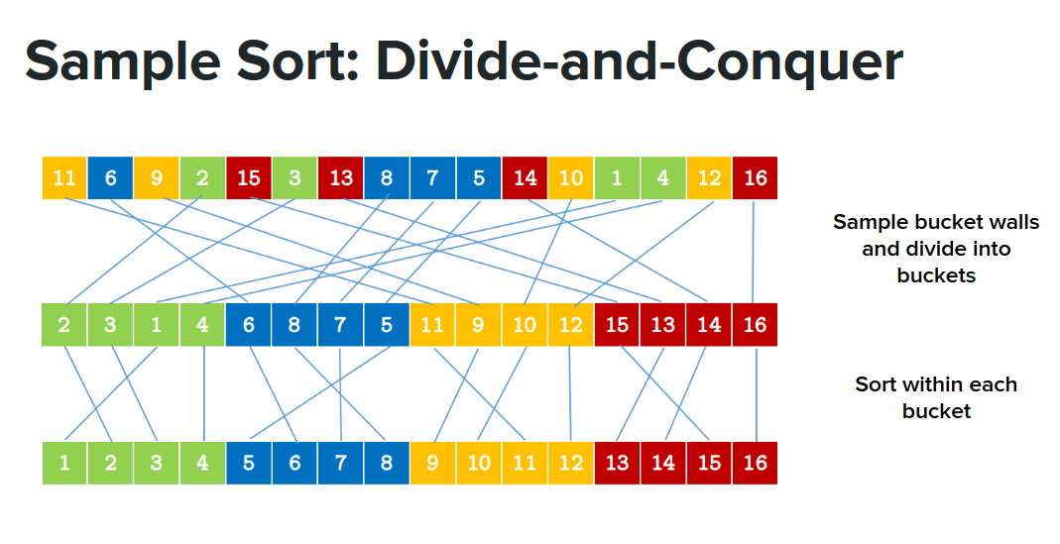
Literature Review – Parallel Sort
Modern architectures are multi-core
Maximise throughput and performance
Divide-and-conquer approach
Sample elements to use as partition pivots
K-partition, instead of halving
Quicksort on individual partitions in parallel
Proposed by Frazer and Mckellar

Slide 13
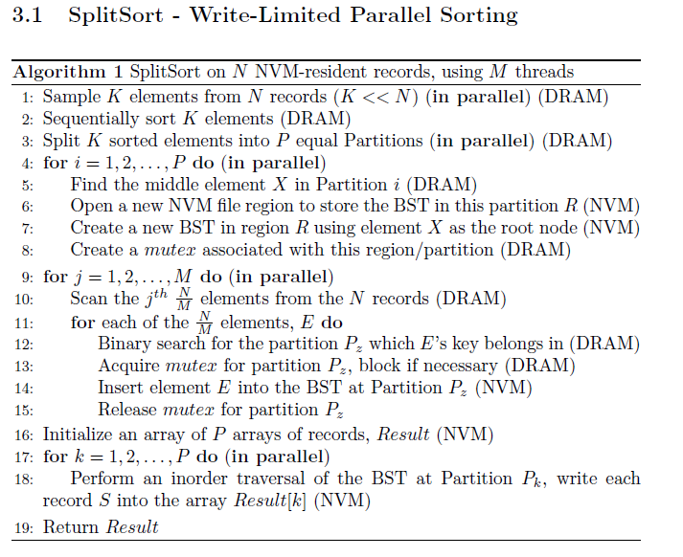
Current Progress – SplitSort (tentative)
Parallel-capable sort
“Write-once” guarantee
Uses BSTs and Sampling/Partitioning technique
Pointer-indirect approach
Sorts mainly in NVM
DRAM-NVM hybrid approach

Slide 14
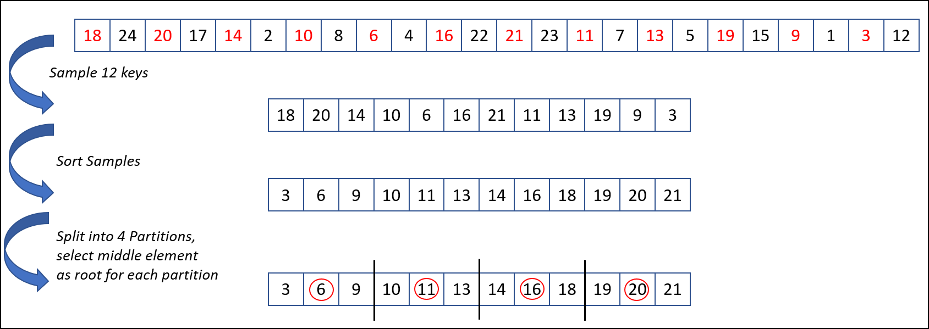
Current Progress – SplitSort
Sampling and Partitioning Phase

Slide 15
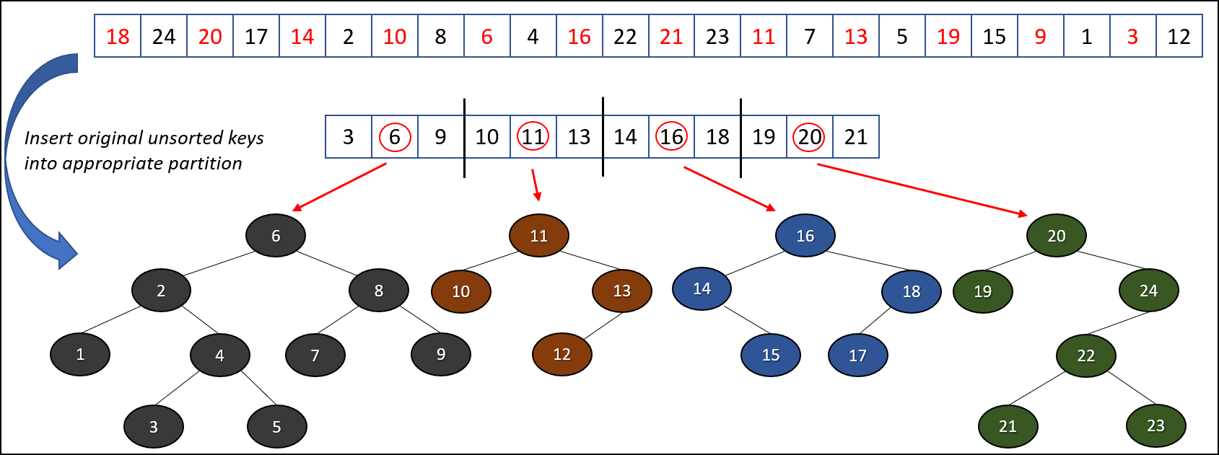
Current Progress - SplitSort
Insertion phase

Slide 16
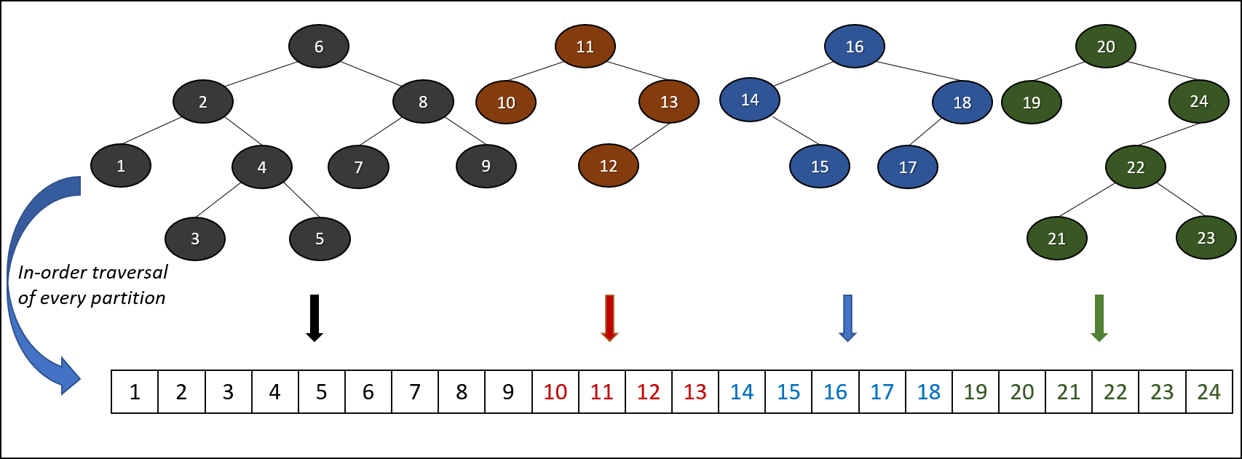
Current Progress - SplitSort
Traversal and Retrieval Phase

Slide 17
Current Progress - SplitSort
Concurrency control – multiple threads inserting into the same BST
Dynamic Partition Sizing – don’t know each partition’s size at compile time
As many samples that can fit in DRAM (more samples is better)
Metadata for each partition (ie. mutex, partition range) in DRAM

Slide 18
Current Progress - Experiments
Uniform Distribution
Two different workloads
Varying number of threads
Benchmark against C++17 Sequential Sort (Introsort)
Implement in C++17, GCC 9.3.0, Intel PMDK Library Direct Acess, App Direct Mode, OpenMP for parallelization, no optimization flags

Slide 19
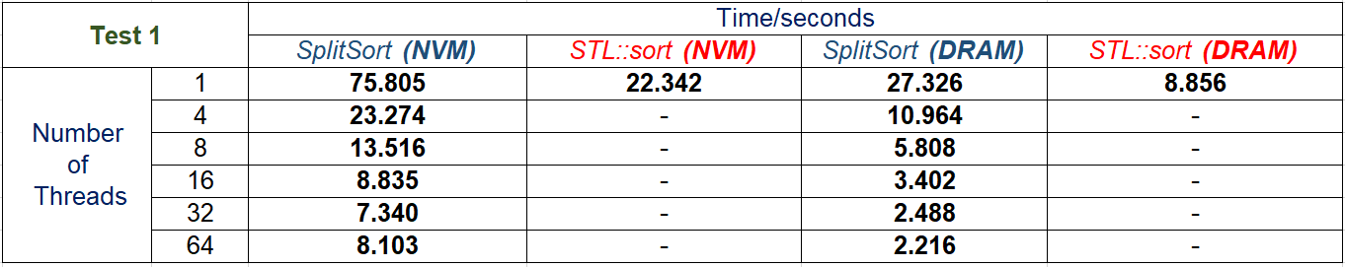
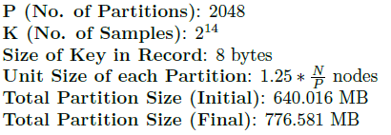
Current Progress - Results
Test 1 (256 Byte record) * 2²⁴ = 4 GB

Slide 20
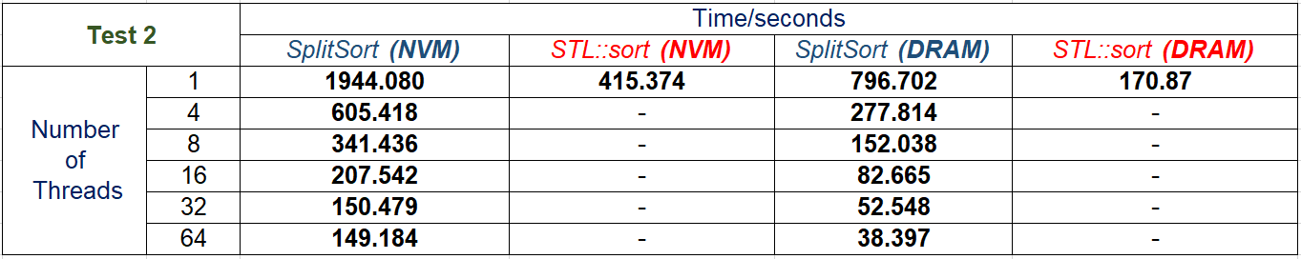
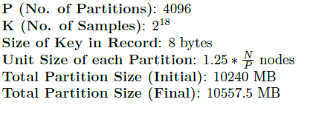
Current Progress - Results
Test 2 (256 Byte record) * 2²⁸ = 64 GB

Slide 21
Current Progress - Results
Single-Thread STL Sort (NVM) Single-Thread STL Sort (DRAM)
Single-Thread STL Sort (NVM) Single-Thread STL Sort (DRAM)
Test 1 (256 Byte record) * 2²⁴ = 4 GB
Test 2 (256 Byte record) * 2²⁸ = 64 GB

Slide 22
Current Progress – Result Discussion
Given enough threads and cores, we can be as fast as the STL Sort
Keep in mind STL Sort is essentially quicksort, O(n²) or O(n logn) writes
Given enough threads and cores, we can be as fast as sorting everything in DRAM using STL Sort
Scalable, but can be improved

Slide 23
Issues and Future Plans
Sampling and Distribution affects performance
Distribution awareness/adaptivity
Performance Tuning – change parameters
Benchmark against other parallel algorithms, explicitly track writes
Cache performance is big consideration
Adaptivity to DRAM size (fall-back to external sort?)
Hybrid Partition Storage (leaves in NVM, internal nodes in DRAM)
B+ tree techniques (multiple elements in one node)

